Slide 1
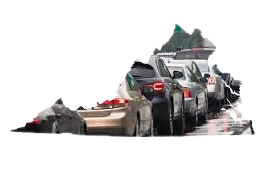
The State of Virginia vehicle Crash Data Analysis from 2020 to 2022
By Selamawit Mekonnen
2024

Slide 2

Data questions?
How has the frequency and severity of crashes varied over time?
Are there distinct patterns in crash occurrences and severity based on the age groups of those involved (senior vs young)?
What are the external factors to crashes in Virginia, such as speed, alcohol, bike, distracted, 'drowsy, drug,, ‘hit and run, large truck?
What are the primary contributing factors to crashes in Virginia?
Investigate the types of collision, the number of vehicles involved, and factors such as weather condition, road surface, road defects and assess if these factors vary based on area type urban/rural classification.
What is the distribution of fatality rate across Virginia counties, and which counties exhibit the highest fatalities rate?

Slide 3
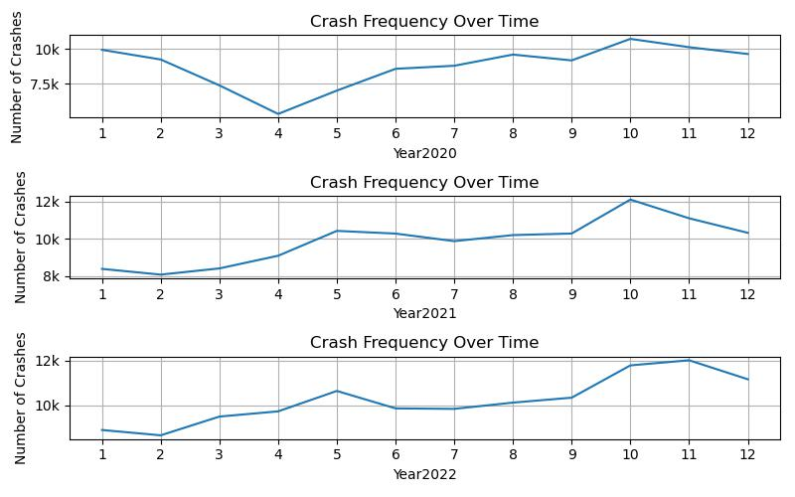
what are the differences in crash pattern based on the presence of work zones and school zones?
How has the frequency of crashes varied over time?
Over the last 10 years, 8,034 people were killed in crashes on Virginia roadways. Of those deaths, 791 - 10% - occurred in October, making it statistically the most dangerous month of the year for crash fatalities.

Slide 4
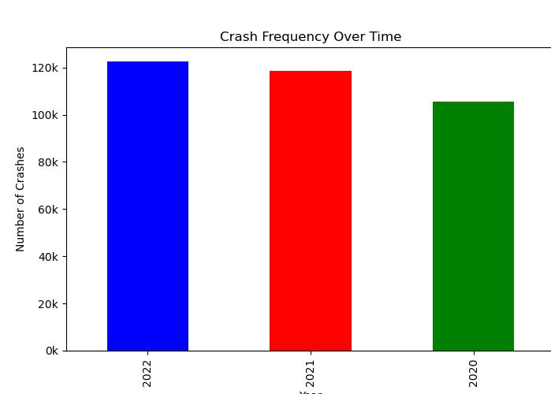
How has the frequency and severity of crashes varied over the years?
In 2022 there was significant increase in the number of crash severity compared to 2021 and 2022 .
In 2022, Virginia's traffic deaths increased to a 15-year high. Some reasons for the increase include:
Driver error: Driver error is the most common cause of car accidents in Virginia. Speeding: More Virginians are dying in speed-related crashes. Drunk driving: Drunk driving may be a factor.
Not wearing seatbelts: People not using seatbelts may be a factor.

Slide 5
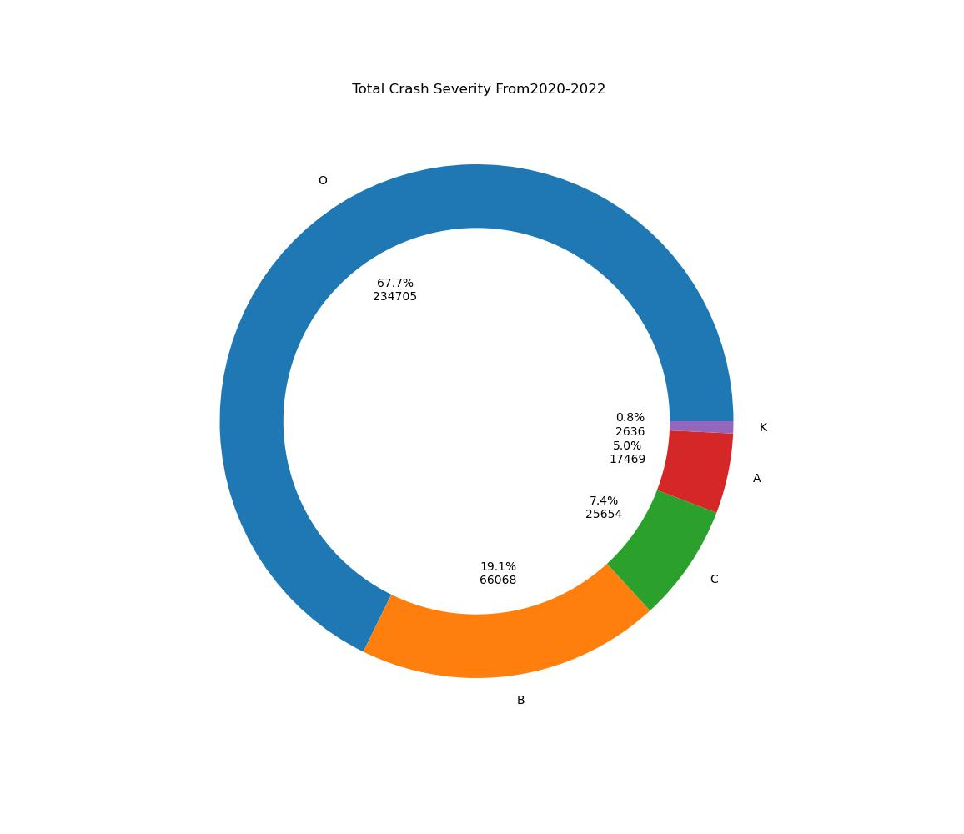
Total crash severity from year2020-2022
For total crash severity distribution represented in a donut chart, the values are as follow
O: Number of crash involved no injuries at the scense:67.7%
C: Possibly ininjury:7.4%
K: Fatal injuries:0.8%
A: Serious injuries:5.0%
B: Minor ininjury:19.1%

Slide 6
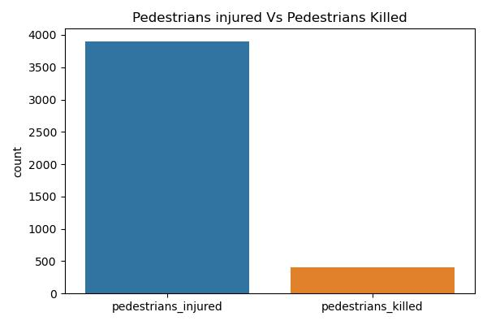
Total count of pedestrian injured, and pedestrians killed

Slide 7
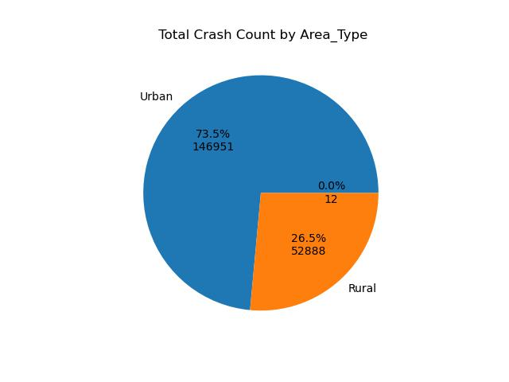
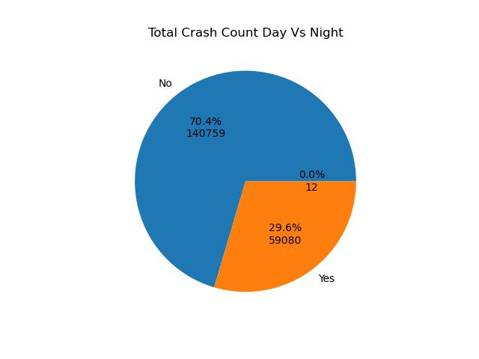
Total Crash count based on Area Type and Daytime vs Nighttime
Conclusion: Almost One Third Of The accidents happen in Urban Area and Day Time.

Slide 8
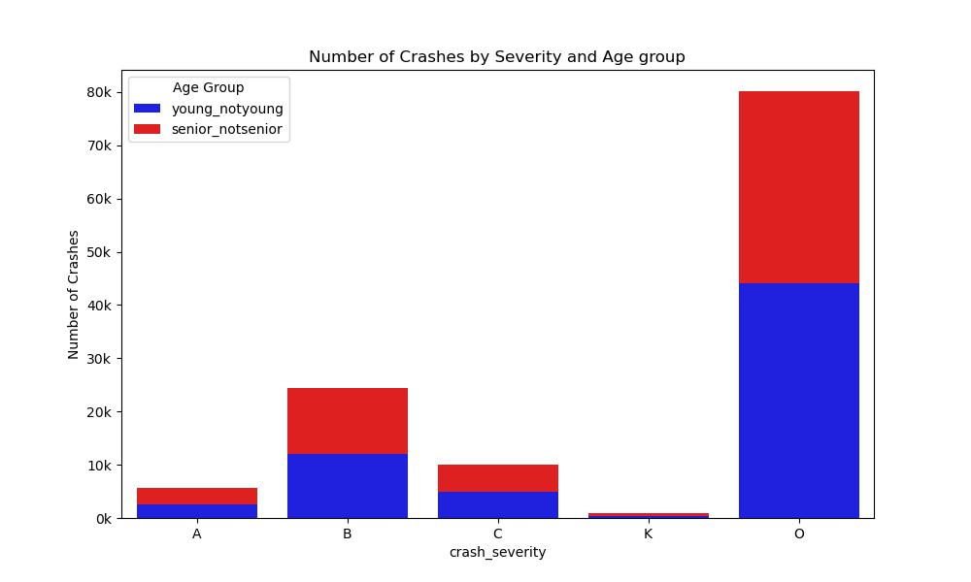
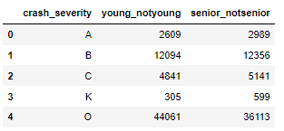
Are there distinct patterns in crash occurrences and severity based on the age groups of those involved (senior vs young)?
A.serious
B. minor
c Possibly
K. fatal
O. number of crash

Slide 9
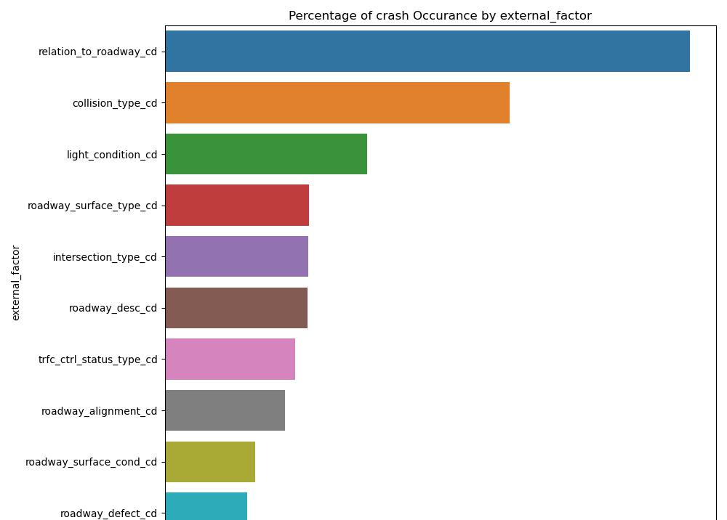
What are the primary contributing factors to crashes in Virginia?
The primary factor is “Relation to Roadway” which include aspects such as the
Crash occurred at an intersection
Non intersection
Entrance/Ramp
Roadway-Mainline and its high-risk areas to contribute accidents.
The second factor are “collision type”
Factors such as rear-end collisions, side impacts,or rollovers can provide insights into driver behevior
The third are because of “light condition”.
Poor lighting, especially during nighttime or adverse weather conditions.

Slide 10
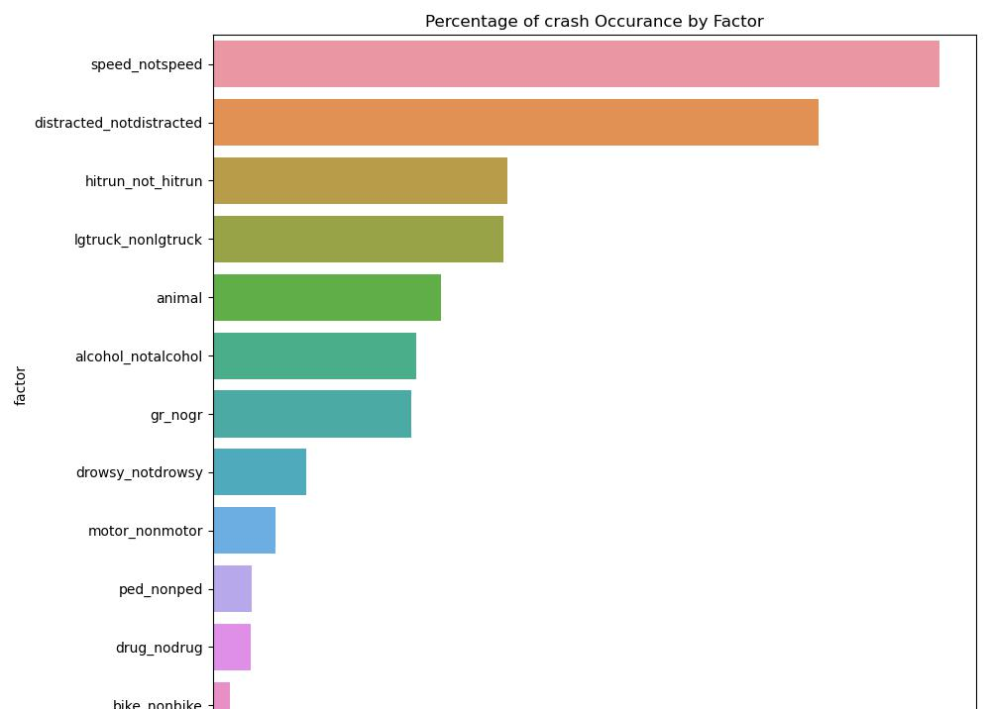
What are the primary contributing factors to crashes in Virginia?
Among these factors the highest percent of crashes is attributed to speeding, followed by distracted driving and hit-and run incidents.
This suggest that drivers driving traveling at high speeds are more likely to lose control or have less time to react to road conditions or action of other drivers, leading to a higher incidence of crashes.
Distracted driving, which can include texting, using a phone, adjusting the radio ,or other activities that take the drivers attention away from the road, it also a significant contributor to accidents.

Slide 11
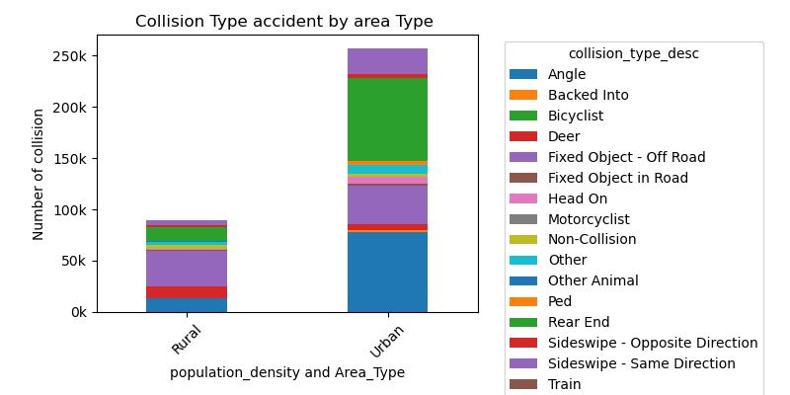
Collision Type accident by area type
Based on the analysis of this bar plots which indicates that the highest number number of collision type is attributed to “Fixed Object/Off-Road” incidents.
Collisions with fixed objects are typically severe due to the abrupt deceleration of the vehicle up on impact, potentially resulting insignificant injury or fatality.

Slide 12
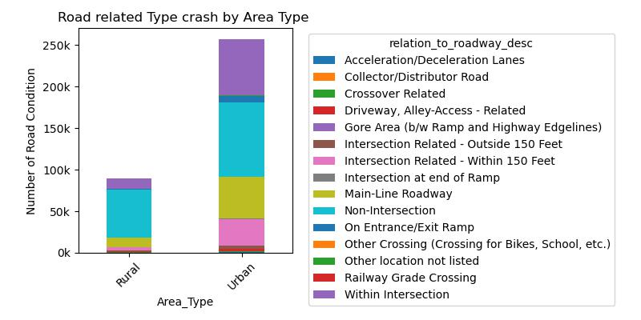
Roads related type crash by area
This Plot reveals a disproportionate number of crashes occurring within gore areas, despite these zones constituting a relatively a small portion of road surface.
This anomaly suggest that gore areas are high _risk location for road users. Factor contributing to this trend include Driver misjudgment, Limited visibility and Illegal maneuvers

Slide 13
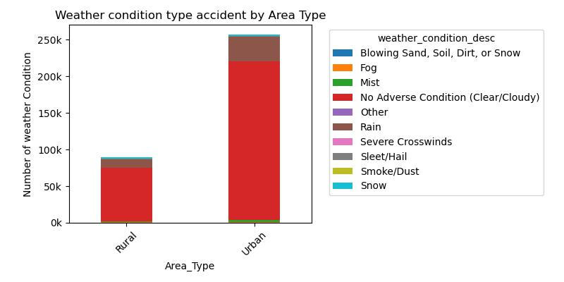
what are the differences in crash pattern based on the presence of work zones and school zones?
Weather condition type accident by area type
The plot demonstrate that weather conditions particularly snow and rain are critical factor influencing traffic accidents in both urban and rural setting.

Slide 14
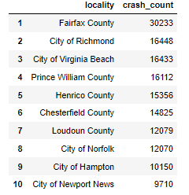
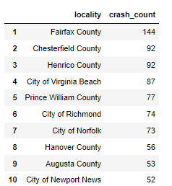
Top ten counties with total killed crash
Top ten counties with total crash

Slide 15

A heat map showing Total crash frequencies through out Virginia

Slide 17

Recommendations
By considering and addressing the factors of relation to Roadway type implement targeted engineering solutions such as signal upgrades, lane markings, and advanced intersection design To enhance safety at intersection.
Introducing traffic calming measures in residential and high crash areas, such as speedbumps, chicanes or narrower lanes.
Implement stricter speed enforcement measures, such as increased police patrols in high-risk areas and the use of speed cameras .
Enforce existing laws against distracted driving more rigorously and consider increase penalty for violation.
Partner with cell phone companies and app developers to create technologies that limit the functionality of devices while a vehicle is in motion.
Increase enforcement of traffic laws during crash peak months. This could include crackdowns on speeding, illegal turns, and enforcement of seatbelts.
Improve Road design and infrastructures
Increase the frequency and efficient of snow removal and de_icing practices, particularly in rural areas where snow can accumulate rapidly.
Conduct ongoing research to better understanding the dynamics of weather-related crashes and the effectiveness of various mitigation strategies.

Slide 18

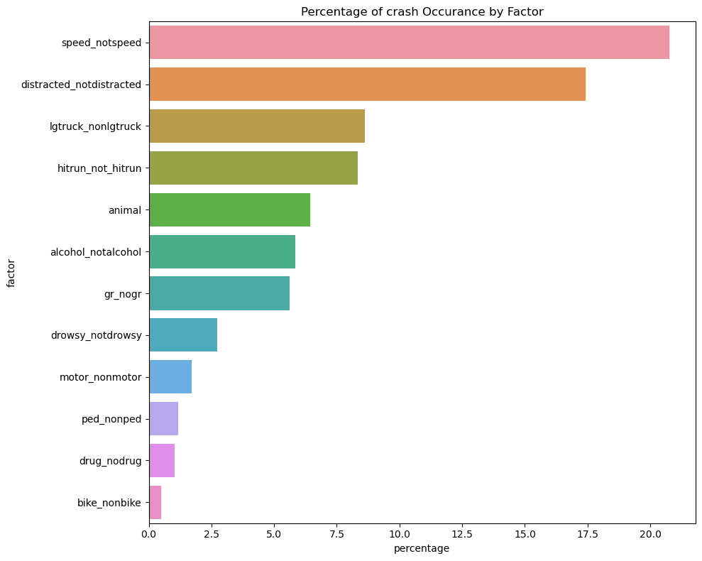

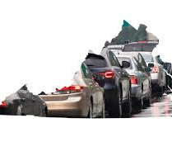
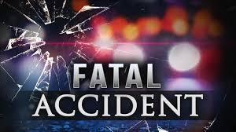
Thank you!
Data source
Business dataset: https://data.virginia.gov/Transportation/Open-View-VA-Department-of-Transportation-Crash-Data/q3i7-ztj9/about_data
Geo-JSON dataset: https://data.virginia.gov/dataset/county-fiscal-stress-2021
Selamawit Mekonnen
2024

